Slide 1
Sales Strategy Presentation to the Sales Team of Pen and Printers
Presented by Ihesiaba Amarachi Adanna-Vivian Data analytics team
Business Goals:
Based on the data, which sales method is best recommended in other to save time and resources if the results are similar.
Following the launch of a new product line, different sales approaches were used and the sales team requested for the following insights:
How many customers were there for each approach?
What does the spread of the revenue look like overall? And for each method?
Was there any difference in revenue over time for each of the methods?
Any other differences between the customers in each group for context.

Slide 2
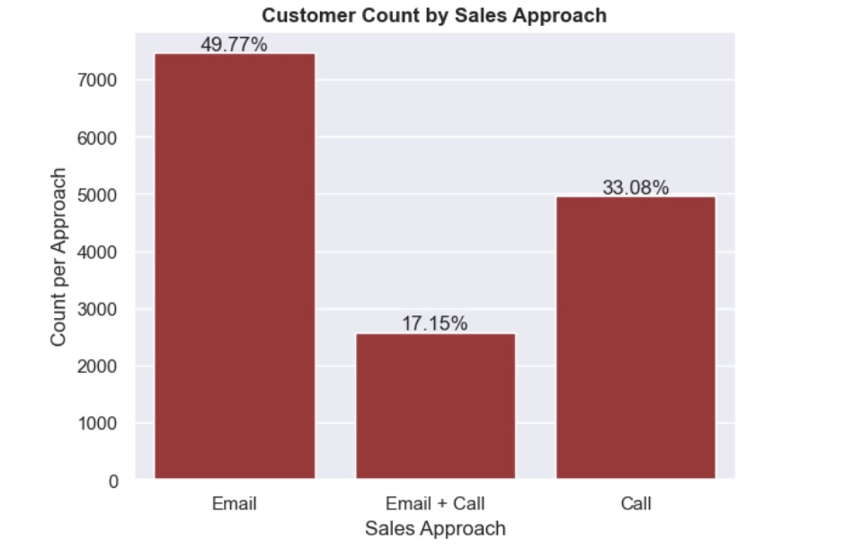
How many customers were there for each approach?
Overview
Approximately, half of the customers were approached only by Email with a total count of 7465 customers. The Call only approach made up about 33 percent of the total customer count with a value of 4961 customers and The Email + Call approach has the least customer count of 2572 customers which about 17 percent of the total population.

Slide 3
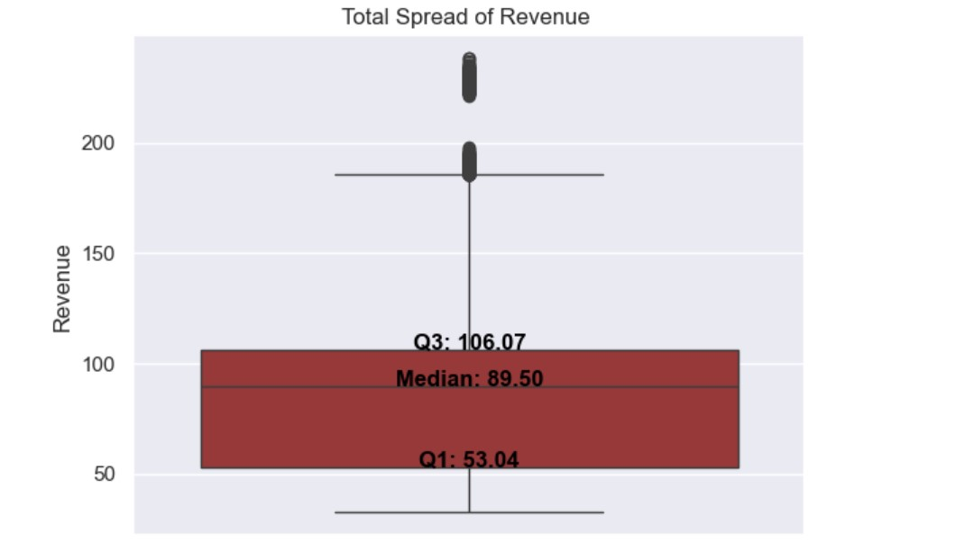
Overall spread of revenue
Overview
The Majority of the revenue of the customer is between 106.07 dollars and 53.04 dollars with most it's values being lower than the median revenue of 89.5 dollars

Slide 4
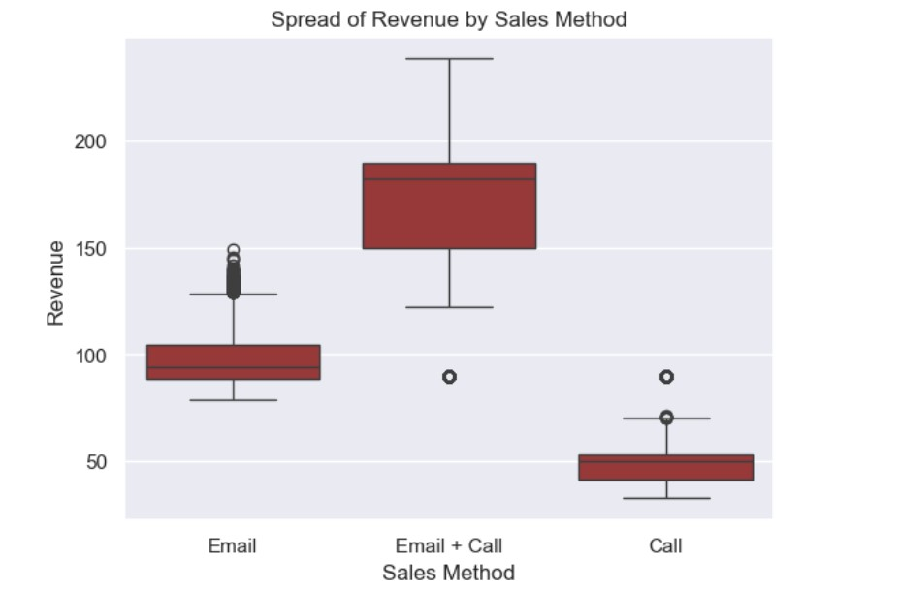
Spread of Revenue for each Sales Method
Overview
The Email + Call method offers a higher range of revenue outcomes but with more variability, while the Email and Call methods provide more consistent, though generally lower revenues with a few high-revenue results.

Slide 5
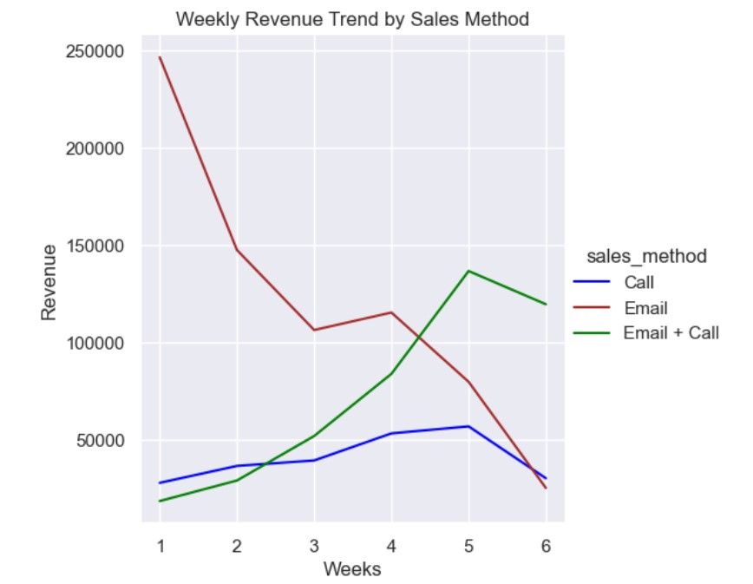
Difference in Revenue over time for each method
Overview
The Email method started with the highest revenue but declined steadily over time, while the Email + Call method showed significant growth, peaking around week 5 before a slight drop. The Call method maintained steady growth throughout the 6-week period.
This suggests that combining emails with calls may be more effective in sustaining higher revenue levels over time compared to relying solely on emails

Slide 6
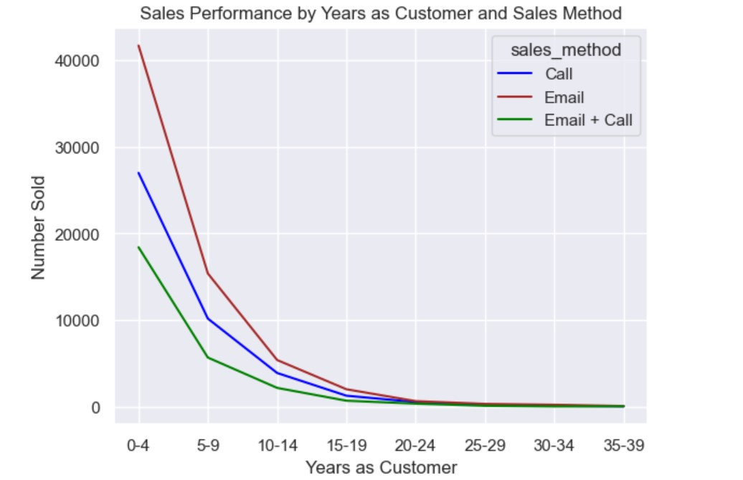
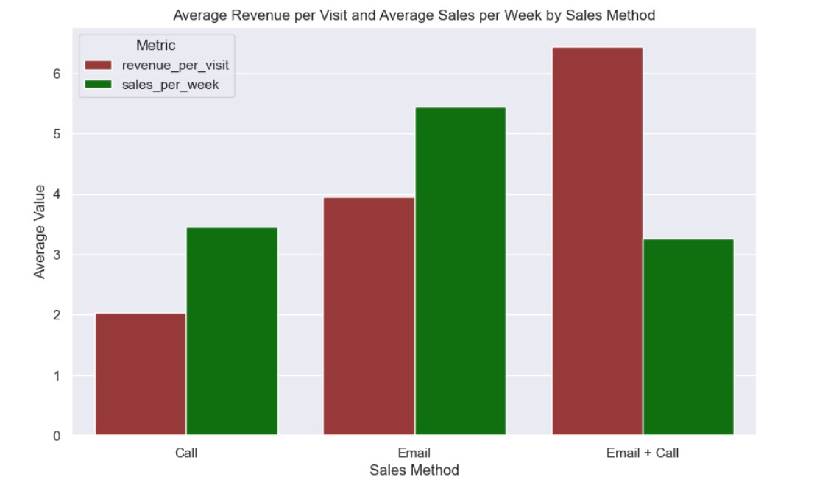
Difference between Sales methods using other metrics.
Overview
Customer Retention by Sales Method
The Email + Call method has the highest average revenue per visit, while the Email method achieves the highest average sales per week.
The Sales performance for all sales method decline for customers with more years in the company.

Slide 7
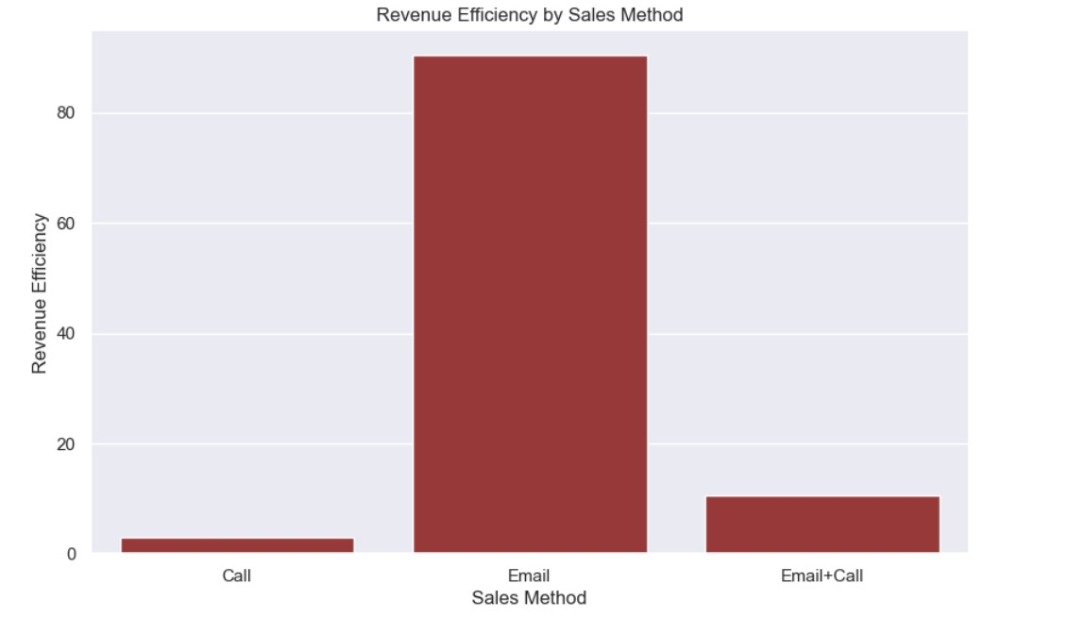
Since our goal is to optimize our time and resources, leading to better allocation of resources and improved overall profitability. I would recommend Revenue Efficiency as our metric. Based on my analysis on the data provided for the past 6 weeks, the use of Email + Call sales method is the best method, As shown in the "Weekly Revenue Trend by sales method" relying only on Email may not sustain high revenue levels and the Call method is not efficient as it consumes the most time.
In Summary

Slide 8
Recommendation
To quickly implement the sales method, we should strategically promote the sales methods with the highest revenue efficiency in the market:
Emphasize on methods like Email+Call that deliver high revenue with minimal time investment and appeals to both cost-conscious and time-conscious customers.
Target segment most likely to respond to the efficient methods(customer with less than 10 years)
Use key metrics to monitor the if the Email+Call method records an increase in total revenue as predicted.
Optimize the call duration to reduce the time spent per customer.
Enhance customer retention over the years.
Data Collection for in-depth analysis
Improve data quality: What other customer demographics and feedback can improve the insights generated? eg. Age,Income level.
Balance the data across the various sales methods and increase the data size.

